Slide 2
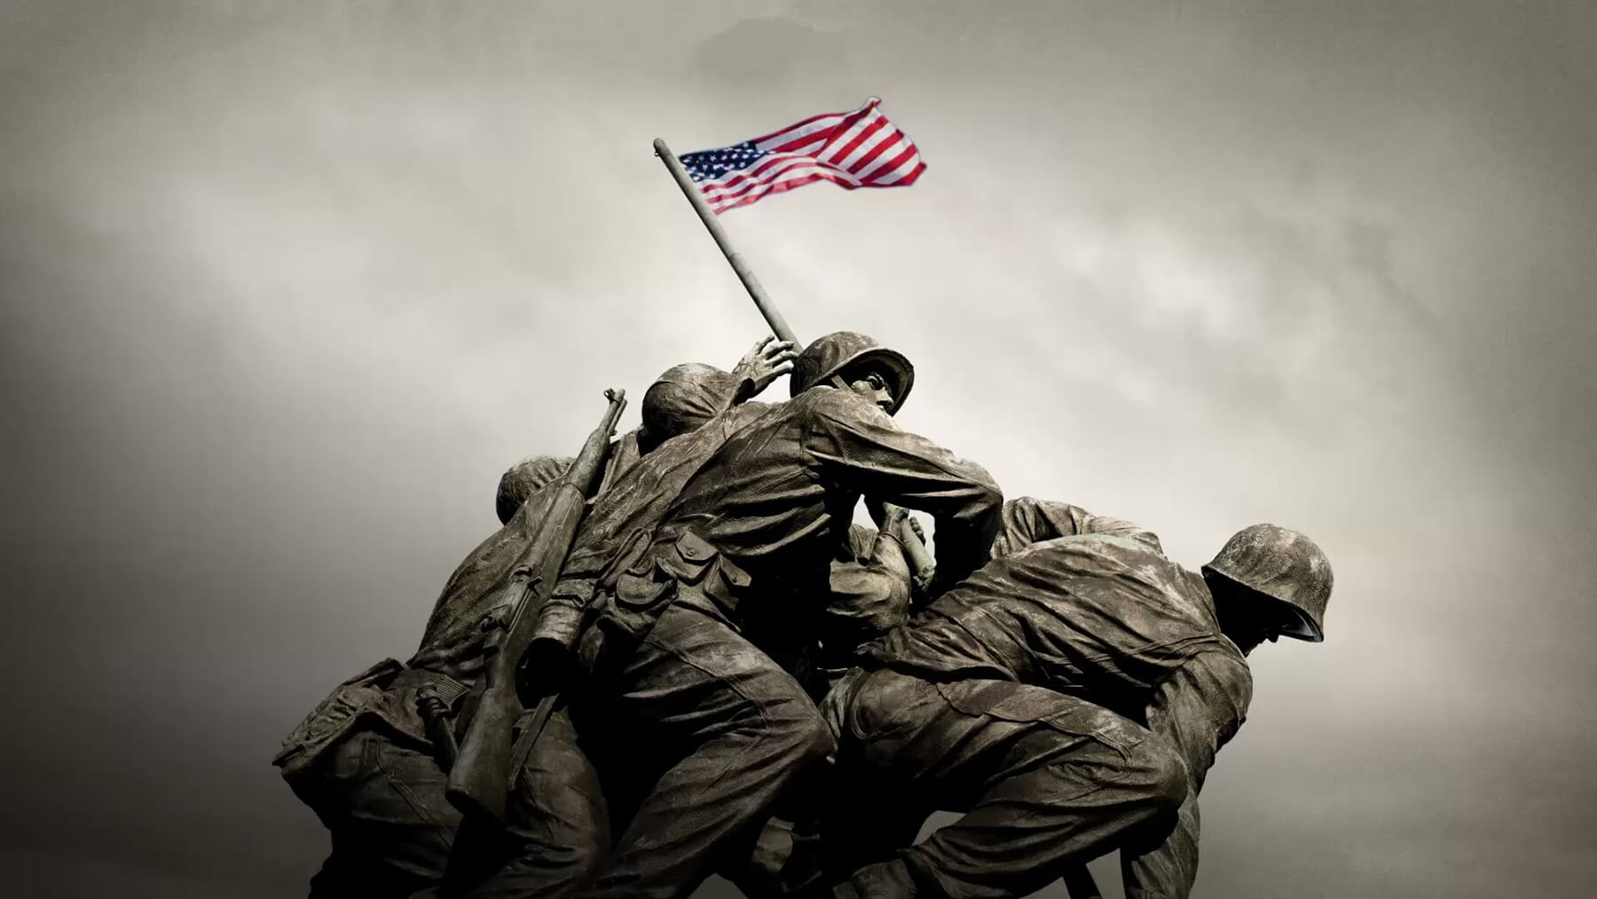
exchange ideas

Slide 3
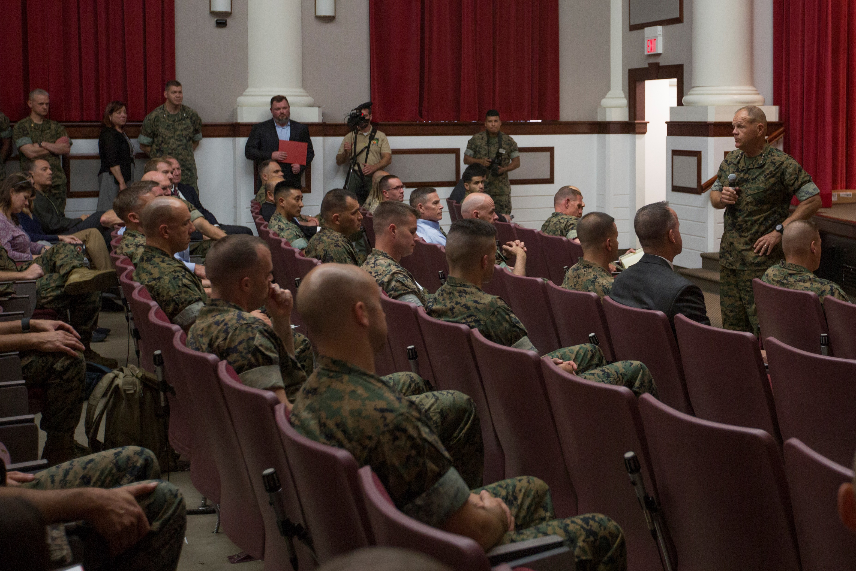
We need to
exchange ideas

Slide 4
Purpose
Capacity
Publishing Guidelines
Response Times
Levels of Discussions
CMC
Innovation
Challenge

Slide 6
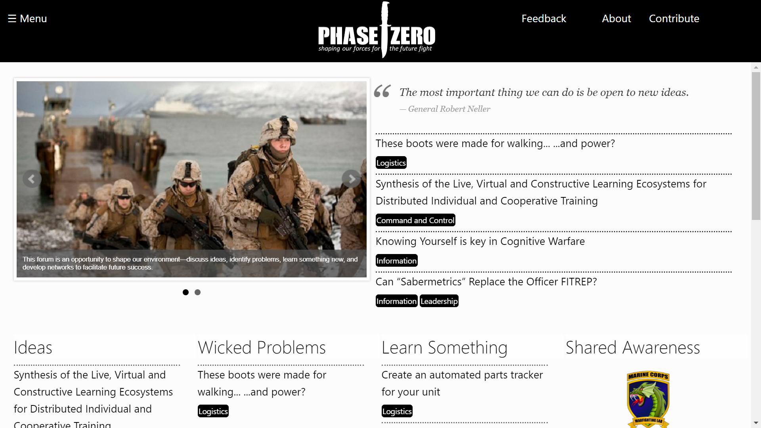
Notes:
Exchange Ideas
Solicit Solutions
Explore Resources

Slide 7
Join your fellow Marines and Sailors in shaping our Marine Corps for the future fight by contributing to the Phase Zero community.
Spread the Word
Code / Develop the Site
Serve as an editor on the board
Contribute Ideas
Submit Resources
Moderate the Community

