Slide 2
Grassroots Innovation We are fostering a culture of innovation within our ranks through collaboration, education, and experimentation.

Slide 3
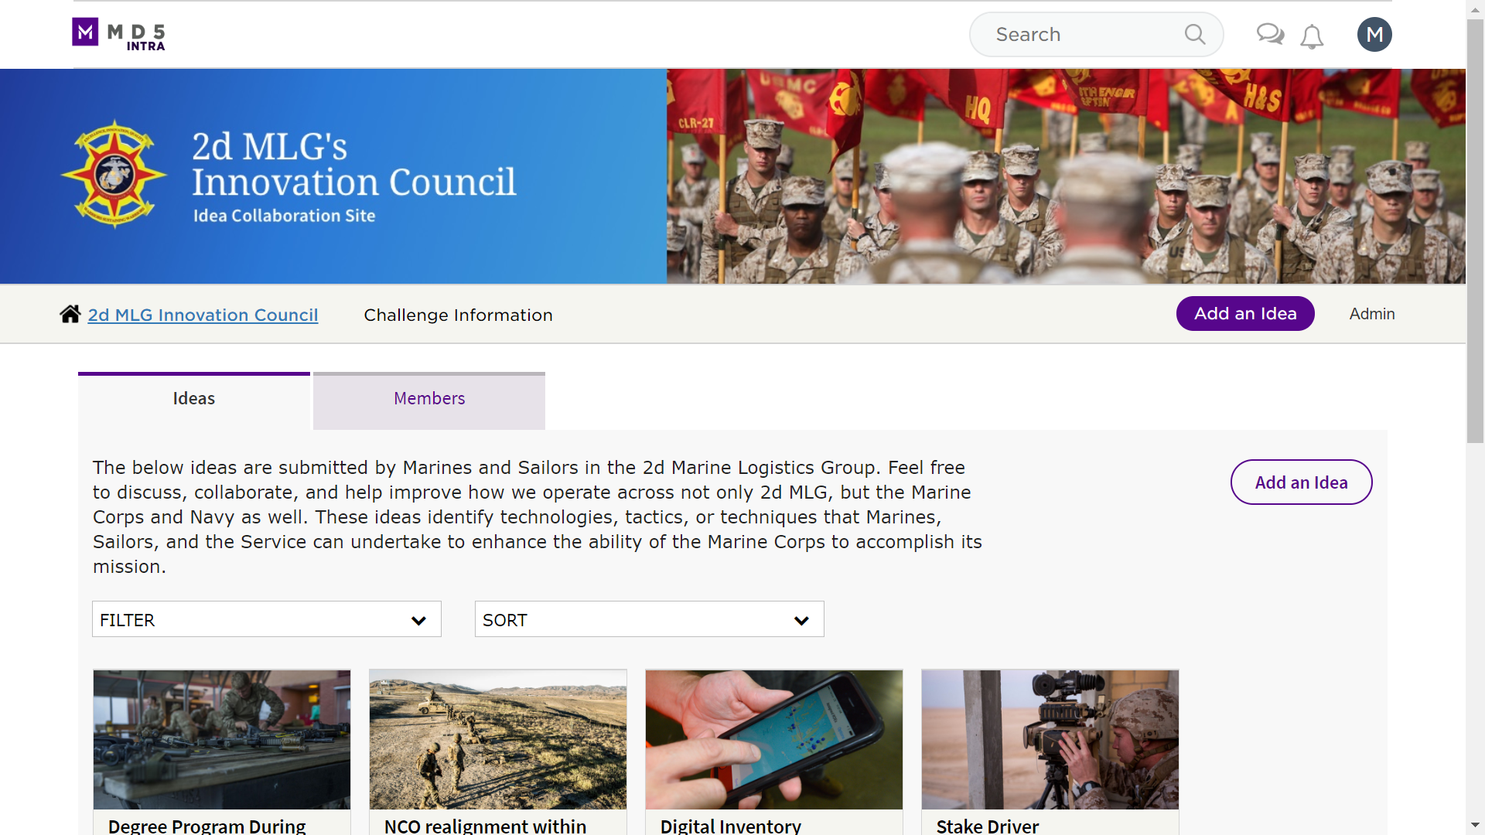
Collaboration
MD5, the DOD National Security Technology Accelerator, developed and hosts our Innovation Council site where we:
• Crowdsource ideas directly from the grassroots
• Enable a continuous exchange of ideas on proposals from the command
https://2dmlg.md5.net

Slide 4
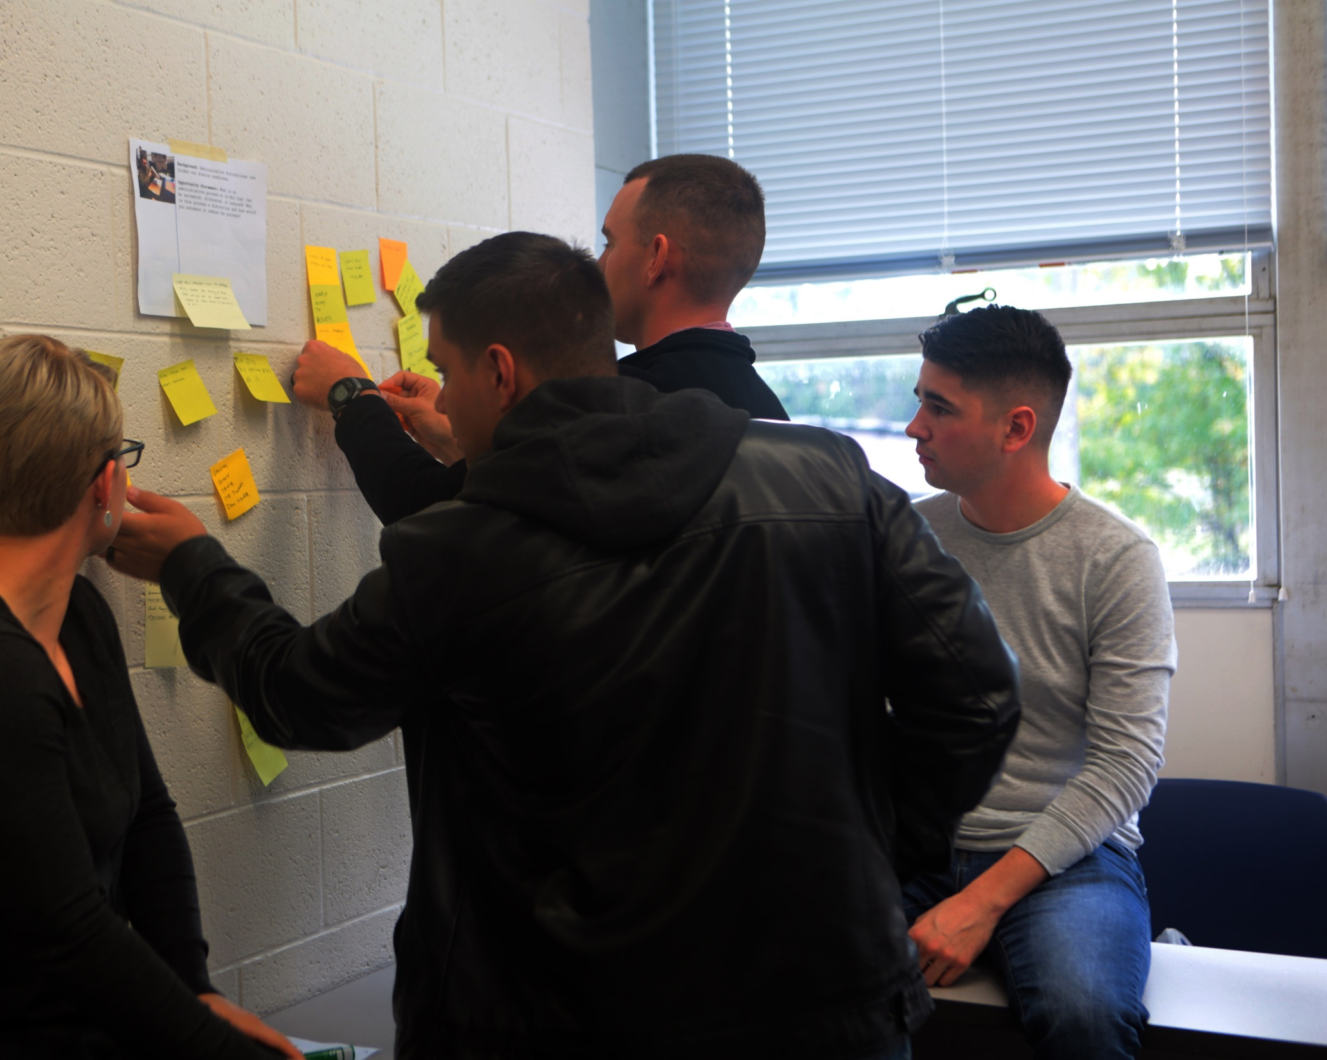
Education
We aim to provide our Marines and Sailors with non-traditional educational opportunities that expose them to new ideas and thought processes by partnering with organizations both inside and out of the DOD.
• Design thinking seminars U.S. Fleet Forces Command
• Lean Startup methodology workshops Defense Innovation Board
• Innovation programs and events UNCW Center for Innovation and Entrepreneurship

Slide 5
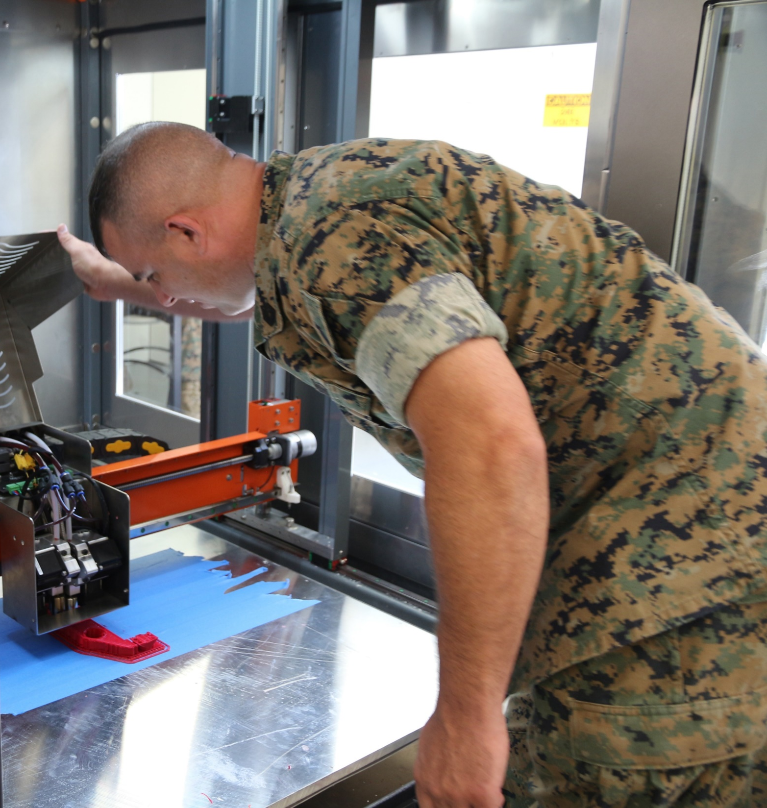
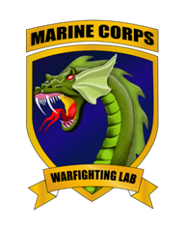
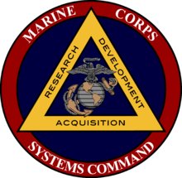
Experimentation
To develop a culture of innovation within our ranks, Marines and Sailors require time, space, and resources to discover and prototype new ideas.
• We opened a Makerspace to provide a physical venue to focus on brainstorming solutions, experimenting with resources, and bringing ideas to fruition.
• We are also seeking sponsorship of hackathons through the UNCW Center for Innovation and Entrepreneurship that will allow us to rapidly prototype ideas using talented minds from the University.

Slide 6
Grassroots Innovation We are fostering a culture of innovation within our ranks through collaboration, education, and experimentation.

