Slide 2
Velocity Lab
July 24, 2018
Daniel Pines
Chief Innovation Officer
daniel.pines@navy.mil

Slide 3
MISSION
Research, develop, test, evaluate (RDT&E), manufacture and provide in-service support of energetics and energetic systems. Provide Soldiers, Marines, Sailors and Airmen with information and technology to detect, locate, access, identify, render safe, recover, exploit and dispose of explosive threats.
Energetics are:
- Propellants
- Explosives
- Fuels
- Pyrotechnics
- Reactive materials
- Warheads
- Rocket motors
- Munitions
FLY FARTHER HIT HARDER SAVE LIVES

Slide 4
MOLECULE-TO-MISSION
6.1
6.2
6.3
6.4
6.5
6.7
Advanced Tech Development
Engineering and Manufacturing Development
Basic Research
Demonstration and Validation
Operational Systems Development
Manufacturing and In-service Engineering
Acquisition Engineering
Fleet Support
Applied Research
Demilitarization/Disposal
SCIENCE AND TECHNOLOGY (S&T)
RESEARCH AND DEVELOPMENT (R&D)
TESTING AND EVALUATION (T&E)
PRODUCT DELIVERY
WARFIGHTER SUPPORT
Only DoN activity delivering both energetics and EOD technology solutions from basic research through disposal

Slide 5
Why Innovation? Why Now?
New (but not really new) Threats
Warfighting technology not developed by (or really for) the DoD

Slide 6
Why Innovation? Why Now?
So what …
Educate S&T workforce on actual current threat
Do better job pulling in technology
Notes:
We are outranged by major competeritor. What our artificial reefs. Where are they. What cabapabilies do they have that we need to defeat. Where will our fleet/marines be? How far away. What is reach of our weapon.

Slide 7
Why Velocity Lab?
Pace of Innovation:
Year-round rolling admissions’ style NISE 219
New spaces on and off-base for collaboration
Direction of Innovation:
Digestible threat briefs, fighting instructions, open source maps of threats …
Pre-populated with COTS Technology
Command receives increased in:
Frequency of innovative concepts
Number and diversity of collaborations
Retention and recruitment
Distribution A (18-177): Approved for public release; distribution unlimited.
Notes:
30 projects in two years
Finished on base. CSM off-base

Slide 8
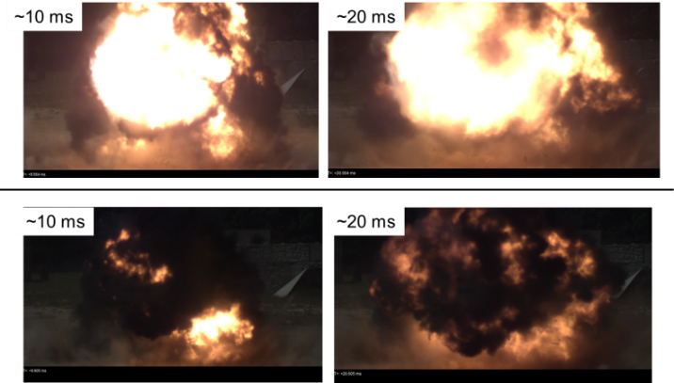
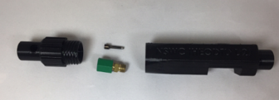
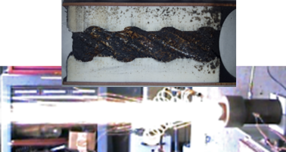
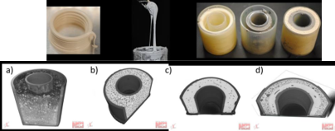
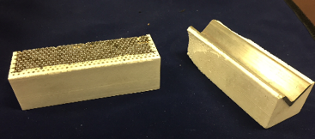
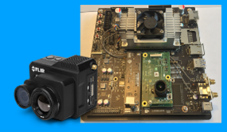
Some of the 30+ Projects

Slide 9
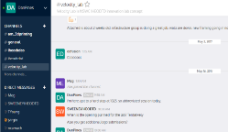
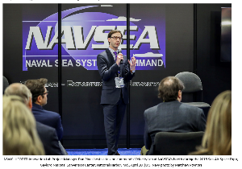
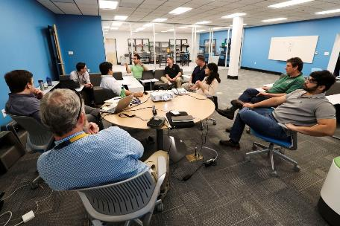
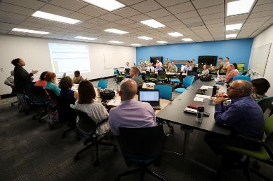
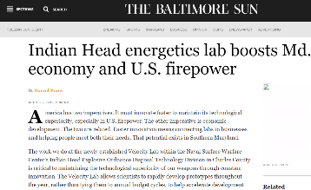
Engaging Internal/External Communities
Distribution A (18-177): Approved for public release; distribution unlimited.

Slide 10
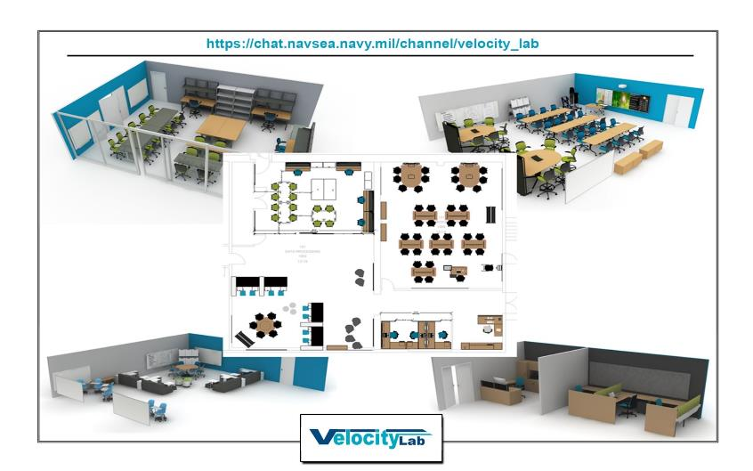
Infrastructure
Prototyping Lab
Conference
Collaboration

Slide 11
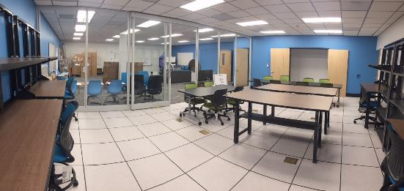
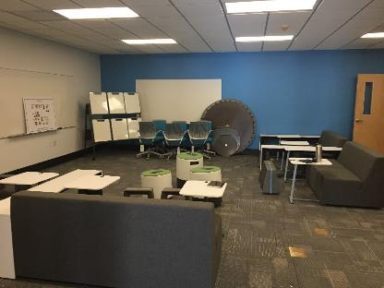
Infrastructure
Conference
Prototyping Lab
Collaboration

Slide 12
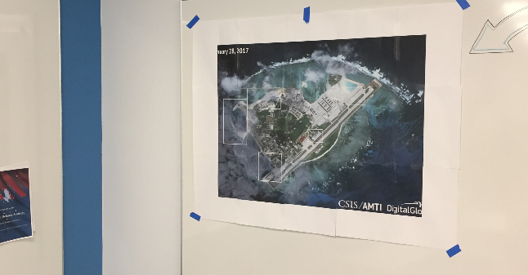
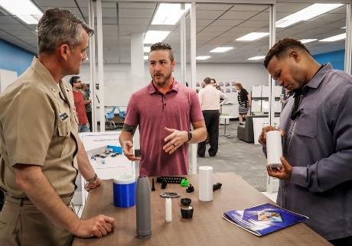
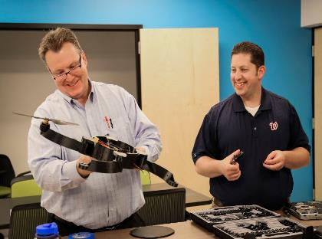
Soft-Opening

Slide 13
What will make this faster?
We need Operation Vignettes to frame our S&T brainstorming.
Relevant to future fight. U, S, or TS/SCI.
We want to know what COTS technology you see as promising.
We know what we think is important.
More of these types of events.
Our workforce is rapidly hiring and retiring.

Slide 14
QUESTIONS?

