Slide 1
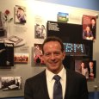
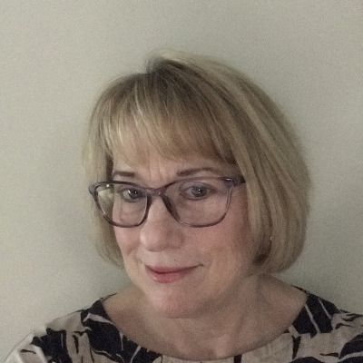
USMC Innovation Symposium: IBM Panel
Lee Angelelli
Executive Architect, Federal CTO langelel@us.ibm.com 1-571-244-5970
Dr. Mohamed N. Ahmed
IBM Distinguished Engineer, Master Inventor, AI & Cognitive Solutions ahmoham@us.ibm.com 1-502-299-7737
Kay Murphy
Global Asset Optimization Leader kaymur@us.ibm.com 1-919-455-5238

