Slide 1
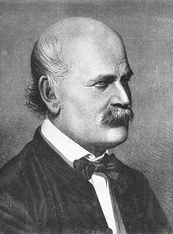
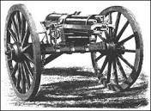
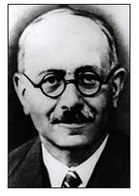
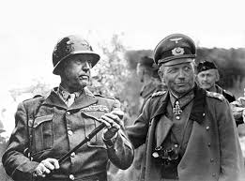
Innovation
Gatling Gun
Dr. Ignaz Semmelweis
Nicolas Appert
Innovation: “….a new idea, device, or method; the act or process of introducing new ideas, devices, or methods”. Webster’s Dictionary
LtGen Mike Dana, USMC
Maj Chris Wood, USMC
"The best way to predict the future is to invent it“
by Alan Kay
This brief has nine slides
Marc Bloch
Patton & Guderian
Notes:
Good morning. I really appreciate the time today to talk to you about Future War and its impact on logistics. The Age of Innovation is upon us and the pace of technological development to modernize warfare in the 21st century is breath taking.
Since this is an innovation symposium, I thought it was important to start with the definition of innovation. The problem with innovation throughout history is it is often under-appreciated or worse yet resisted, because it often goes against the status quo. On the top left of this slide is Dr. Ignaz Semmelweis, who in 1847 concluded that the failure of Doctors to wash their hands caused the spread of disease. Dr Z as I will call him was a man before his time and his ideas were absolutely correct, but he was derided by the European medical community and he died a broken man in an insane asylum for his efforts. Not the model for this innovation symposium. Next you will see the Gatling Gun, invented and patented by American inventor Richard Gatling in November of 1862. Though several Union commanders bought this gun at their own cost, it was not adopted by the US Army until 1866. This is an example of innovation not being adopted because of a status quo mindset.
A more positive example of innovation is that of Nicolas Appert. In 1795 the French military offered a cash prize of 12,000 francs (44,000 US dollars in 2016) or a new method to preserve food. After 15 years of experimentation, Appert submitted his invention and won the prize in January 1810 on condition that he make the method public. Canning provided armies the ability to cut their ties to foraging and carry sustainment on their person and in their logistics trains….a revolutionary capability.
Innovation in science is important, but the operational design that applies this technology is just as important. In the lower left of the slide you see a picture of Marc Bloch...a French soldier in WWI who served on the French General Staff at the outbreak of World War II. Bloch writes a book called "Strange Defeat" in which he talks about the German ability to out-think and adapt to the new rules of 20th century warfare. He calls the French defeat, a defeat of the mind, because unlike the Germans they could not apply the benefits of tanks, radios, and motorized warfare into their way of war. Conversely, Heinz Guderian of "Achtung Panzer" fame was one of the architects of blitzkrieg. General Patton, in a cropped picture next to Guderian wrote about the value of tanks and motorized warfare, but in practice Guderian and the German Army were the first to bring this capability to the WWII battlefield.

Slide 2
The Vision – and the Reality
The Vision
Technologically: Additive Manufacturing, Autonomy, Artificial Intelligence, Unmanned Systems, Hypersonics, Advanced Sensors, Mobile Devices, Mixed Reality, Counter-UAS, Long-Range Missiles, ….?
Operationally: Marine Operating Concept + Expeditionary Advanced Basing + Littoral Ops In Contested Environments + Multi Domain Battlespace + …?
The Reality (The Marine Corps Has Been Here Before…But It’s Been A While)
What’s Easy
Buying New Tech
Writing New Concepts
What’s Hard
Turning Concepts & Tech into Competitive Doctrinal Advantage
Altering Higher & Adjacent Policy
Leadership Change Management
Manpower Process/Career Management
Accelerating Capability Development/Acquisition (and Sustaining It)
Creating the Conditions for Innovation: Start from the Innovator and Work Backwards
The Organization
The Leaders
The
Innovator
Notes:
In vision, the Marine Corps is actually working to step out against many of these concepts and technologies.
There are focused and resourced efforts targeting many of these key technologies laid out on the last slide.
The past three years has seen an influx of bold new concepts that have the potential to transform the MAGTF and the overall Marine Corps.
However, there is much work to be done. In many ways – we have only scratched the surface of what will eventually be a very difficult journey.
We’ve started with the right first steps – understanding these emerging technologies, and putting hard thought into how they enable future warfighting.
What will be exponentially harder is the other 90% of the work left to be done. We have to turn these concepts into actual doctrinal advantages. We have to implement those proposed advantages into new leadership priorities, new policies, new manpower models, new training regiments, and we have to fundamentally change the speed at which we continue to adapt and sustain ourselves.
I propose that it’s not about finding the “next greatest idea” – it’s about creating the organization-wide conditions that will enable innovation to occur, and for the Marine Corps to harness that innovation into at-scale implementation across the Corps.
To do that, we need to start with our endstate in mind: An empowered innovator. We should identify when and how innovators are already doing their work, and then design our organization to replicate that model at-scale and in accelerated timelines.
That design will then move to the next layer out – the hierarchical managers and leaders who oversee innovation in their organizations. Not every manager is a leader; not every leader is a manager; but both of those are often the lynchpin to effective or failed innovation.
In our pyramid hierarchy, nearly anyone in the chain of command can stop a good idea, conversely, everyone must agree to a new idea for it to continue. This culture must be overcome to allow both incremental innovation and disruptive innovation to occur.
Finally, we need to ask how we design the processes, policies, and culture of our organizations that create the structures for those leaders, managers, and innovators to do their work. What are their incentives? What are we measuring? Who is accountable for what? Are any of these things optimized to create successful conditions for our innovators?

Slide 3
Innovation for the Innovator
“Those who are crazy enough to think they can change the world usually do.” ― Steve Jobs
Find or create your quest
“Never doubt that a small group of thoughtful, committed citizens can change the world; indeed, it's the only thing that ever has.” ― Margaret Mead
Find or create your tribe
"Innovation— any new idea—by definition will not be accepted at first. It takes repeated attempts, endless demonstrations, monotonous rehearsals before innovation can be accepted and internalized by an organization. This requires courageous patience." — Warren Bennis
Persist until the right time.. or be ready for a fight to create the right time
“There is an art, it says, or rather, a knack to flying. The knack lies in learning how to throw yourself at the ground and miss.“ - Hitchhiker’s Guide to the Galaxy
Get uncomfortable again and again
Notes:
After nearly 4 years of attempting – and more often failing – to innovate in HQMC, I want to lay out some of the many lessons I’ve absorbed. Some of this is through failure, some is through mentorship, and some is through looking at innovation outside – our own history, other services, academic literature, and industry.
The first two are from one of the CIA’s lead innovators and Deputy Directors, Carmen Medina. She articulates the need to find your calling in innovation, and to build a tribe around you. Ideally, these are things that you can find that already exist – but in many cases you will have to be that initial catalyst with all the passion that the role requires. In short, if innovation feels like another job – then you’re probably not doing it.
I’ve had to learn – again and again – that all change hinges on one key ingredient. Timing. There will come a time where you’ll have to make a judgement call about whether you want to wait for the right timing, or you want to create that time on your schedule. Both are hard, but in very different ways.
I’ve learned that if you’re truly creating powerful change– then it should feel messy, uncertain, and that you’re nearly always swimming upstream. The hope is that you’re fighting against improving your idea, and not fighting against your own people. Unfortunately, the latter is too often the case in large organizations and particularly the Marine Corps.

Slide 4
Innovation for the Leader
Inspire your people with vision
“The best way to predict the future is to create it.” –- Alan Kay
“The best leader is he who has sense enough to pick good men to do what he wants done, and self-restraint to keep from meddling with them while they do it.” – Theodore Roosevelt
Free your people with intent – then get out of the way
Serve your people by removing their barriers
"Every act of creation is first of all an act of destruction." – Picasso
Empower your people with – authority, autonomy, and investment – in that order
"People want to be given responsibility to help solve the problem and the authority to act on it." – Howard Schultz
“The significant problems we face cannot be solved at the same level of thinking we were at when we created them." ― Albert Einstein
“I am looking for a lot of people who have an infinite capacity to not know what can’t be done.” – Henry Ford
Organize for Thought Diversity
Notes:
If you are a leader – my ask to you is that you not immediately stop trying to be the innovator.
Your first job is to inspire your people to create a new future. You can do this by constantly communicating the imperative for change and setting forth the vision for your end state, at a conceptual level. It does NOT require you to have any brilliant ideas – only to listen to others. Even if you can’t do this basic thing – many managers struggle with this, you can at least do the rest of this.
For the leader-innovators out there, please here me carefully! There is a role for everyone to innovate, but if your role is to lead innovation – than you have to get out of your peoples way. When a leader comes in with all the bright ideas, then the leader immediately suppresses the necessary exploration and candid feedback that the innovators need to be successful. The key to innovation is that the first idea is nearly always the wrong idea. But it’s a starting point that takes you on a journey towards the right idea.
In order to get your people to that right idea, you have to be willing to destroy their barriers – which is often a matter of not having any tradespace for your people to think, plan, execute, or invest. Said simply – what are you willing to STOP doing so that you can start something new?
Next, you have to empower your people. They have to move at the speed of trust, and they do that by taking ownership of their destiny, making their mistakes, and iterating towards innovation.
Finally, I encourage you to think very critically about how you organize the innovation projects that you commission. If you always bring in the same people who use the same methods, then why should you expect anything different than what is already being done? Inject bold new inputs with diversity of thought – people new to the problem, people that are critical, junior people, senior people, non-Marines, ANYTHING to ensure that basic assumptions are questioned.

Slide 5
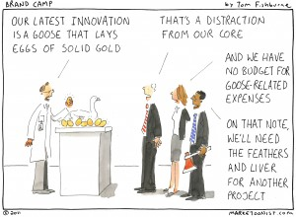
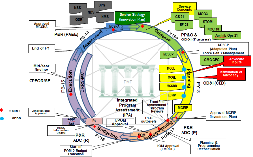
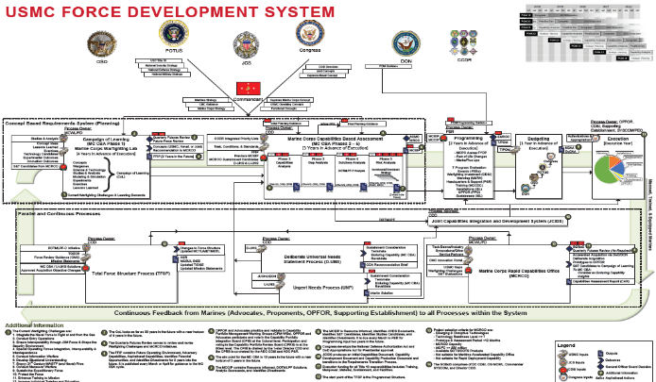
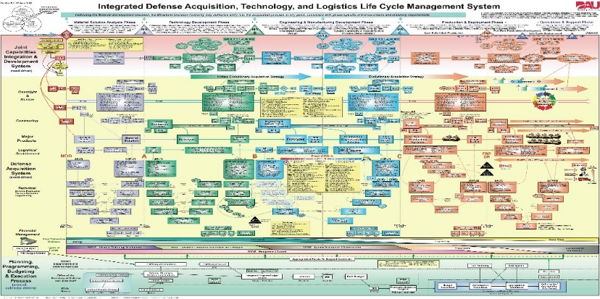
Current State of Organizational Innovation
Tendencies – Heroic initiatives, uncoordinated activities; discovery by accident, not on purpose
Culture – We have a culture of excelling in silos and we struggle to “cross-lead”
Capability Development – Designed for major acquisition efficiency & oversight – not designed to outpace adversaries and technologies
USMC Force Development Process
4 Year Process, By Design
DoD JCIDS & Acquisition System
6.5 Year Average; 7.5 for Software (Source: GAO, 2014)
Day 1 Recognize Idea or Need
+1-2 years
Concept Validation & Insertion, Studies, Analysis, and Wargaming
+3 years
USMC-Approved Requirement
+4 years
Executable Budget
+ ~5 years
Milestone A
+ ~7 years
Milestone B
+ ~9 years
Milestone C
+ 10.5-11.5 years
IOC of Deliberate Capability Fielding
+ 1.5 years
Urgent Need / Rapid Capability Office
+ ~3-5 years
Accelerated AOA
+ 4.5-6.5 years
IOC of Rapid/Urgent Need Capability
Notes:
Today
Current system is optimized against a Soviet-era adversary, designed to linearly evolve our capabilities over time by adhering to annual strategy documents and consensus-driven processes.
This system tends towards isolation, heroics, and cyclically-driven re-learning to make the same mistakes as our predecessors
This fundamental system has served the DoD/Marine Corps for decades – so what’s the problem?
1)Speed, 2) Tradespace, and 3) Adaptability
Speed: The rates of adaptation - both adversaries and technologies - are consistently outpacing our ability to move an idea into at-scale fielding.
Tradespace: Hyper-focus on process leaves out the tradespace to focus on other things – either disruptive new capabilities, or finding ways to aggressively divest of existing capabilities
Adaptability: The need for consensus and documentation makes it extremely difficult to achieve surprise through our capabilities, or adapt ourselves for boldness

Slide 6
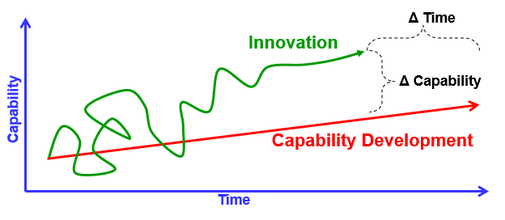
Objective State of Organizational Innovation
“The way to succeed is to double
your failure rate.”
– Thomas Watson
But How? A: Innovate Through Principles, Not Process
“I don't believe in process… at a lot of big companies, process becomes a substitute for thinking. You're encouraged to behave like a little gear in a complex machine.” - Elon Musk
Some Organizational Innovation Principles to Start With…
Build
Measure
Learn
Ideas
This… | Not That…
Build at the Speed of Trust | Speed of Consensus
Fail Fast to Learn Fast | No Failure means No Learning
Ruthlessly User-Focused | Ruthlessly Process-Focused
Invest-As-You-Prove | Invest-To-The-Plan
Iterative, Continuous Delivery | Milestone, Episodic Delivery
Distributed Decision Making | Centralized Control
Data
Capability
Notes:
Tomorrow
So if we were to start again, to design ourselves for innovation – what would that look like?
Of course, we don’t have all the answers, but we know some of the basic characteristics
First – we must embrace the risk inherent in meaningful innovation. That means actual mistakes and failures. That doesn’t absolve us from ensuring that those mistakes are the “right mistakes”, ones where we document what we’ve learned and move forward.
The chart in the upper right is actually stolen from Dean Kamen, the inventor of Home Dialysis machines, the Segway, and the multi-flavor soda dispensing machines. He actually spoke here at our first symposium two years ago, and reiterated the inherent mess of innovation – but ultimately it should deliver either faster or better solutions.
Must stop looking at innovation as some uber process or set of processes. Instead, we have to deliberately establish the right conditions to enable trust, speed, and adaptability.
In many ways, we don’t know what we don’t know – but we know enough to start. It’s about allowing ourselves to think again, and creating the space for us to embrace innovation when it occurs around us.
We do this by iterating rapidly through concurrent and distributed cycles of “Build – Measure – Learn”. This moves ideas into capabilities, and back into data that we can re-harness for more and better ideas. This self-reinforcing cycle provides a virtuous ecosystem that is constantly improving and delivering, rather than our current trend to increase complexity and increase process.

Slide 7
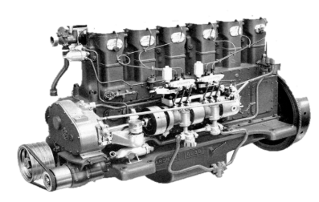
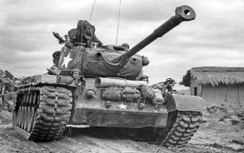
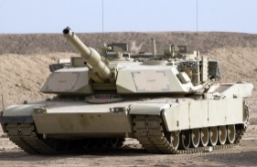
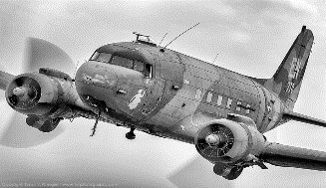
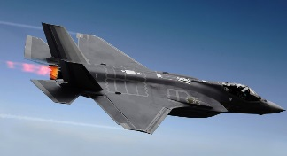
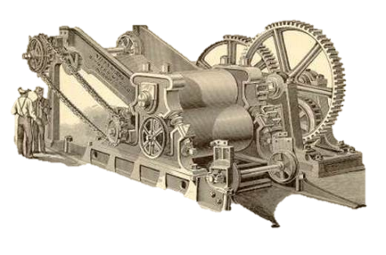
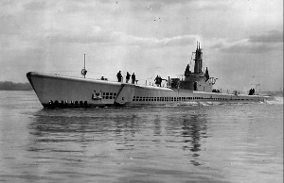
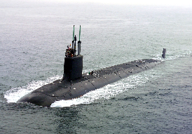
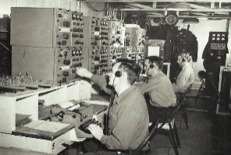
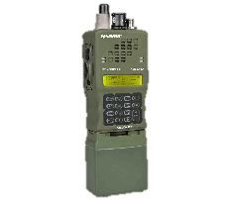
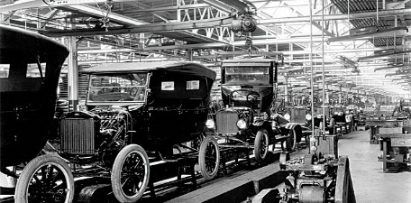
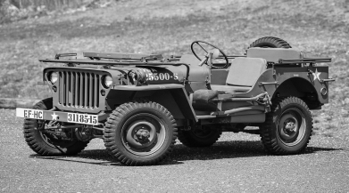
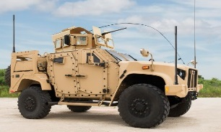
Vannevar Bush
Combustion
Interoperable Parts
Mass Production
Notes:
On a recent trip, I read the autobiography of Vannevar Bush---who was FDR’s head scientist in WWII. In this book he said you could trace all weapon systems of WWII to the combustion engine, Eli Whitney's interchangeable parts, and Ford’s mass production line. Bush said everything in WWII….with the exception of the atomic bomb….could be traced back to the Industrial Revolution technology that was introduced in WWI. In WWII we evolved and matured this technology with great devastating effect on our enemies. We can also say that these technologies continued to be matured and were used on the battlefields in Kuwait, Iraq, and Afghanistan. This ties into our concept of hybrid logistics, a blend of old and new. Today’s logisticians have to support Industrial Revolution platforms that are more complex, heavier, and fuel-maintenance intensive, while incorporating new technology that makes us more agile, mobile, and lethal. More on that in the next slide.

Slide 8
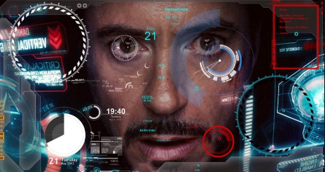
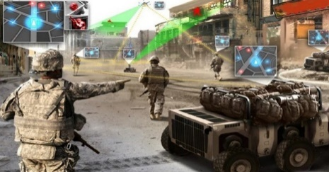
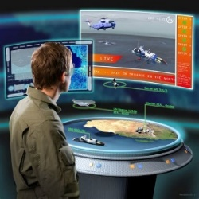
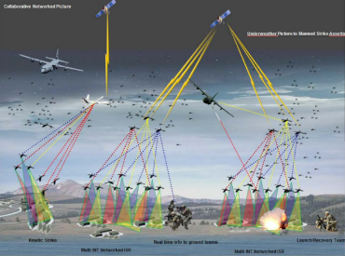
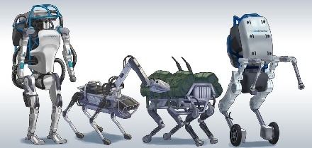
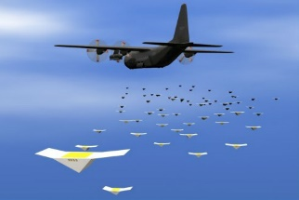
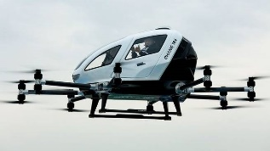
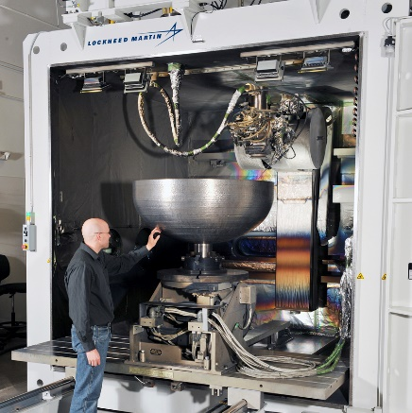
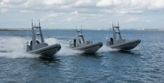
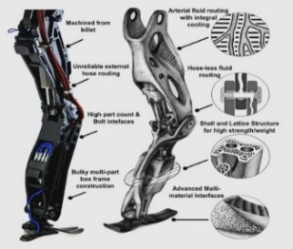
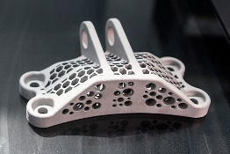
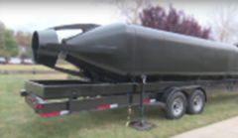
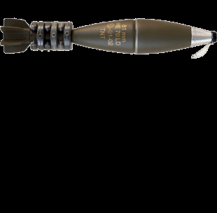
21st Century Vannevar Bush
Artificial Intelligence
Robotics & Autonomous Systems
On-Demand Manufacturing
(+ Energy, Quantum, Hypersonics, etc.)
Notes:
Vannevar Bush architected the future of the DoD for the next 50 years. We are at a similar period of technological disruption, requiring a new architecture that is purpose-built for today’s modern context.
We think that there are at least three domains of technology that are converging to change not only the character of warfare, but possibly even it’s nature.
As we move from very basic automation and towards machines that can learn, think, and even generate their own ideas - AI will continue to rapidly evolve. This is likely less about Terminators and more about Jarvis – computers that we can use to export the complexity of battlefield decision making.
Robotics and unmanned systems are quickly maturing – both in what they can achieve and how cheaply they can be produced. Swarms are now a reality, and advanced humanoid robots are being developed that will be able to maneuver right alongside our forces. The drone pictured is actually a cargo drone capable of carrying two people – and is already routinely operating in Hong Kong and Dubai.
On-Demand Manufacturing, aka 3D printing, isn’t just producing widgets and small plastic parts. The space industry is producing at-scale rockets. We can already do horizontal and vertical concrete printing. We can make complex legacy assemblies into single prints that are optimized for strength and weight. We’ve already printed an entire Seal Delivery Vehicle, as well as enhanced lethality munitions.
With all this said – we must realize that the technology is only the starting point.
Sciaky’s EBAM systems are known for their scalability and speed, with machines capable of producing parts ranging from 8 inches (203 mm) to 19 feet (5.79 meters) in length at speeds of 7 to 20 lbs. (3.18 to 9.07 kg) of metal per hour.
The 300 drones used at the Super Bowl

Slide 9
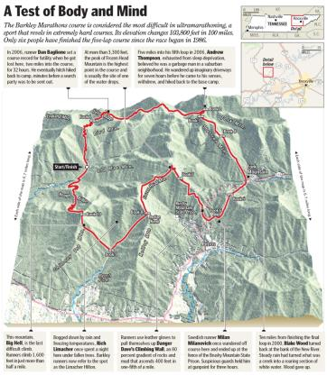
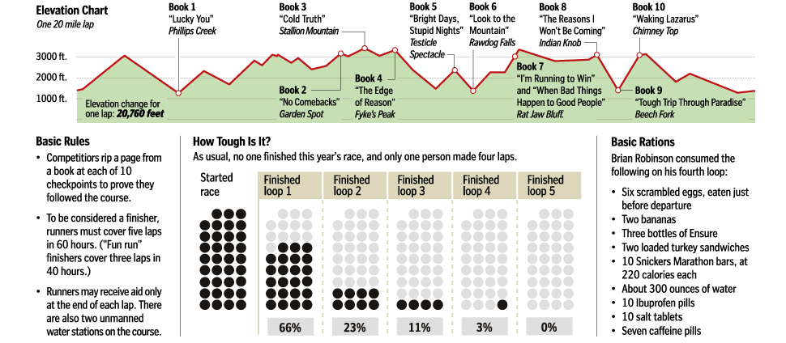
Discussion
“You can’t accomplish anything of meaning without the possibility of failure.” – Lazarus Lake
Notes:
I leave you with one final story and quote.
In 1986, Lazarus Lake was inspired by a local prison break to create a 100 mile race in the backwoods of Tennessee – there’s a great netflix on it called “The Barkley Marathon.”
Competitors complete 5 25-mile laps, in any direction they choose, and on courses that change year to year. Typically there is approximately 105,000 feet of elevation change within this 100 miles, and at one point there’s a 1600 foot climb in about half a mile. There is a single master map that is shared among competitors at the start of the race, and then given back to the race coordinators prior to the race starting. Entrance fees are usually a license plate and whatever Lazarus Lake wants for the next year – one year it was white button-up shirts. Most everyone that attempts this WILL fail, in fact many years no one even finishes the race. And yet this is one of the most pinnacle racing events of the year for a particular class of elite distance runner.
This is incredibly emblematic of the lifecycle of true innovation. Many of our processes here in HQMC are designed to mitigate any risk of failure. However, the role of innovation is to fail fast, and fail smartly, and then pivot to the next idea until you get to success.
The Marine Corps demands that we get this right, and we must start designing ourselves as such.

Slide 10
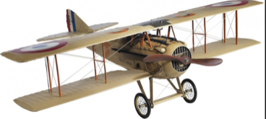
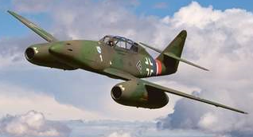
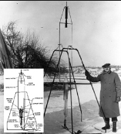
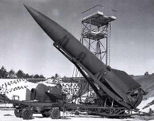
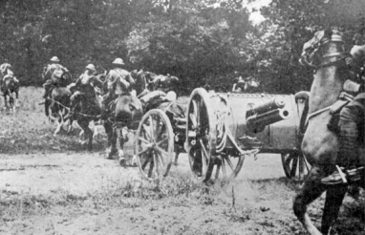
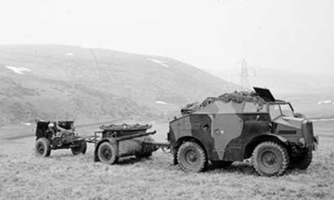
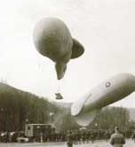
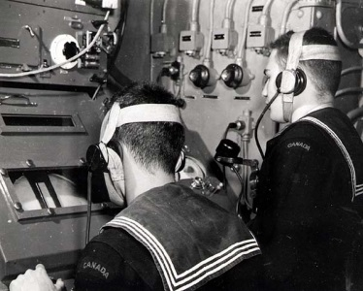
The Speed of Innovation!
Biplane Fighter
Speed: 186 MPH
Messerschmitt Me 262
Speed: 541 MPH
Goddard Rocket
Altitude: 41 feet
Speed: 60mph
V-2
Altitude: 60 miles
Speed: 3580mph
Horse-Pulled Artillery
Truck-Pulled Artillery
Man-in-Balloon Spotting
Radar/Sonar
Notes:
When I talk about innovation some say things are really not that different today than in the past and things will not change that much in the future. My counter to that is technology since the onset of the Industrial Revolution has been moving at break-neck pace. Let’s look at the 1925-1945 period in history for example.
Let’s say you were a WWI veteran with extensive combat experience and you are at the Quantico airfield in 1925. You would look up in the sky and see a bi-plane moving at 180 mph, no pressurized cockpit, but based on your time in the trenches you know this aircraft was both lethal and reflected the advent of technology in a new domain. Who would think (20) years later the Germans would build a jet aircraft with a speed of over 500mph, (4) 30mm cannons in the nose, and for the night fighter version with radar that was blasting Allied bombers out of the sky? In the 20’s you likely would have read about Dr. Goddard who was experimenting with rockets in the mid-west US….and though limited in capability would evolve into the V-2 rocket that the Germans used to bomb England in 1944. Of note, Dr. Goddard tried to sell this technology to the US military without success. Instead German scientists who read his extensive writings on rocketry developed the V-2 and were working on a rocket which could have ranged New York City. Traveling at speeds unheard of for the time, this rocket foreshadowed the ICBMs and SCUD missiles of today. My grandfather was a WWI veteran and he was in artillery and his job was to take care of the horses pulling artillery. Who would think that in WWII, the United States Army in the European theater of war was largely motorized? Lastly, if you ever watched the movie The Red Baron, you remember Allied and German planes doing their best to shoot down observation balloons which were the “ISR” platforms of their day. (20) years later we had moved beyond balloons and had developed radar and sonar to detect enemy aircraft, ships, and submarines.

Slide 11
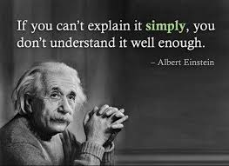
The way you look at the problem, can be the problem…..
…the power of combinations and perspectives…
Distill complexity into actionable parts….
Notes:
An old boss of mine used to say, “the way you look at a problem can be the problem.” In that vein and this is one of my favorite quotes, if you watched the movie Godzilla backwards, which was produced by a survivor of the Hiroshima bombing by the way, the movie is about a giant lizard who helps rebuild a half-burnt down city and then moonwalks back into the ocean.” When I was the PACOM J-5, I was always impressed by Far Eastern culture, which looks at problems in an “inside out, outside in, 360 degree” way. This quote reinforces that observation and is in stark contrast to the US way of war which at its core is based on engineering and mathematical principles. West Point and the Naval Academy are each at their core engineering schools. The United States…we are a nation of businessmen and engineers who believe any problem has an entrepreneurial or technological solution. In the Far East those cultures tend to look at issues in a holistic, multi-faceted way (cultural, diplomatic, economic, historical, and economic). They also design initiatives that are long term (decades), not short term (months, years). My point to this is we in the US military often default to a mathematical solution in war, vice looking at all aspects of a problem (think the occupation of Iraq in 2003). Next is Steve Jobs, a mercurial and difficult man, but an innovation genius. I ready his biography and what was most impressive was his ability to bring together a team that had a diverse and rich career path….that included “tours” in human resources, product development, experimentation, sales, and financials. By surrounding himself with people with multiple skill sets and experiences, he was able to bring new ideas to the table and have them “murder boarded.” In the book it talked about a VP who said, “The money person in me doesn’t like the development cost of this new technology, but from a sales aspect I know the customers will love it…” In this cross pollinating way, Jobs was able to dominate market share with Apple. Lastly, we all know Einstein was a genius and had many great quotes, but my favorite is…”if you can’t explain it simply, you don’t understand it well enough.” I always tell the I&L logistics innovation team we have to “sell” our ideas in a way that your Uncle Joe can understand. Granted, Uncle Joe is a college graduate with military experience, but the point is we need to distill complex ideas into easily understood actionable parts.

Slide 12
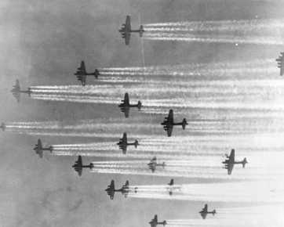
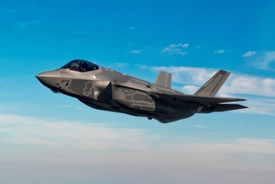
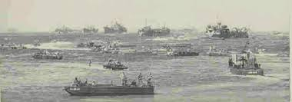
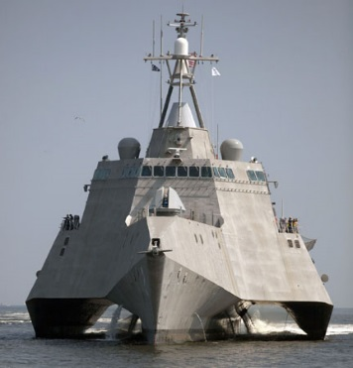
Then…and Now….
Three dimensions of warfare…….
Five dimensions of warfare……….
Air
Air
Space
Sea
Sea/Sub-Surface
Land
Cyber
Land
Notes:
In the 20th century---war was---for the most part---fought in the three dimensions of sea, air, and land. In WWII in the Pacific---in 1944 and 1945---the US had sea and air control---with the asymmetric kamikaze attacks off of Okinawa being an exception to that rule. Of note, when the Japanese looked at the projected US invasion routes to the Japanese mainland that were near Taiwan they were initially perplexed by the limitations of their aircraft in terms of range. They solved that problem by making the Japanese pilot missions one way, not round trip. Brilliant if not conducive to preserving pilot lives. In WW II, though we had sea, sub-sea, and air control---we did not have superiority or supremacy on land---as those were heavily fortified by the Japanese and required massive amounts of forces and casualties to seize, hold, and control. As an example---the (36) day battle for Iwo Jima resulted in 6,821 US killed, 19,189 wounded, out of a landing force of 110,000. 27 Medals of Honor were awarded in that battle and one out of three who hit the beach were killed or wounded. This WWII version of anti-access area denial was the only time in the Central Pacific Island campaign where the Japanese forces ashore took fewer casualties than US forces. I point this out because better technology and industrial superiority does not always equate to dominance in every warfighting domain.
In the 21st century we will fight in five dimensions and near peer---and non-near peer adversaries have the ability to "have game" in each of these domains---as proven by Hezbollah in Israel in 2006. Technology…readily accessible---can and will be applied by our future enemies.

Slide 13
American Way of War (19th & 20th Century)
Notes:
Along these lines---the American Way of War from the Civil War through the 20th century was based on mass, mobility, and firepower. In the Civil War rail and ship provided the Union a well fed and provisioned Army that at could be moved rapidly at the theater level. The 15,000 man 23d Corps was moved from Tennessee to Wilmington NC in 19 days in 1864. In World War 1 the Germans thought it would take us two years to move 1 million troops to the fight, while we moved one million in a year---and 2 million by Armistice Day. In WWII we truly were the arsenal of democracy---when we provided 2/3rds of all war material to the Allies in that conflict---producing 88,000 tanks---303,000 aircraft, 2.4 million vehicles and 4 billion rounds of ammunition. We also built 5,000 grey and black bottom ships and put nearly 17 million in uniform. The American way of war has been a reflection of our economy. The Industrial Revolution provided the production means to generate combat capability that at the end-of-the-day allowed us to overwhelm our enemies with mass. Though our foes were often as tenacious (the Japanese) or more skilled tactically (the Germans) the guarantor of success in WWI and WWI was the ability to mass armies and their firepower to overwhelm our enemies.

Slide 14
Then…and Now…
OIF / OEF
Future Threat
FOB
FOB
X
FOB
X
X
FOB
CD
Air / Sea Dominance
Secure Air & Surface LOC’s
Assured C4I
Static AOR
Contested Air / Sea / Space
Intermittent Air / Sea LOC’s
Degraded C4I
Fluid – Dynamic AOR (s)
Notes:
The good news is in today’s Marine Corps we have many combat veterans from Iraq and Afghanistan. The challenge is we have many Marines with combat experience in Iraq and Afghanistan. In OIF/OEF we were---at the operational level---in a “static” AOR where we dominated the air, sea, and C4I domains. Though the enemy through the use of IEDs was able to impact our vehicular movements, we were dominant in fires, logistics, and had secure communications. In the future operating environment we can’t count on strategic, operational, and tactical dominance and in fact, our lines of communication, communications, and forces will be at risk in each domain. That operating environment will also be very fluid and expansive, especially in the Pacific. This doesn’t’ mean we can’t fight and win, but what it does mean is we will need to be able to operate under combat conditions not seen since the early stages of WWII.

Slide 15
More Advanced, More Costly, More Weight
Marine Corps Infantry Combat Equipment
Weight: 23K lbs.
Range: 265 nm
Cost: $26M
Main 2015 Cost Drivers
(No 2000 Equivalent)
Radio Set $3,872
SAPI $2,205
IR Laser $1,331
Rifle Optics $ 865
$8,273
Weight: 33K lbs.
Range: 428 nm
Cost: $67M
CH-46
In 1980 the “per-Marine planning factor” for strategic airlift was 295 pounds.
In 2010 that number was 400 pounds.
Fuel consumption: 380 gal
Lift: 14 troops; 4K lbs.
cargo
MV-22
Fuel consumption: 2040 gal
Lift: 24 troops; 20K lbs.
cargo
75 pounds
93 pounds
Weight: 3950 lbs.
Cost: $1K
Marine Corps Infantry Bn 2000 vs. 2015
USMC infantry battalion in 2001 = 3,205 PEIs.
USMC infantry battalion in 2012 = 8,400+ PEIs.
Major Plus-Ups
RADIO SET
COMBAT OPS CENTER
COMD AND CNTRL
SAPI
TRUCK,UTILITY
ARMOR SET
LAUNCH UNIT
NIGHT VISION DEVICES
M151 Jeep
Fuel consumption: 17.3 MPG
Production Rate: 1 per
1.5 minutes
MRAP
Weight: 30 tons
Fuel consumption: 5.6 MPG
Cost: over $500K
15
Notes:
Earlier in the presentation we talked about the cost and complexity of today’s weapon systems. My uncle was a Marine in WWII and he did the Roi-Namur, Kwajalein landing. He was my height and weight at the time and I asked him what he went ashore with. He had an M-1 carbine that weighed about six pounds, two canteens, two grenades, a helmet, and a bedroll. In total about (30) pounds of “kit”. He was very mobile, if not survivable. Fast forward to Iraq and the average Marine was weighed down with roughly (100) pounds of gear. SAPI plates, comm gear, NVGs, etc. I often talk about BGen Dale Alford who in order not to be shot and killed, with 100 pounds of gear on his body, had to jump off a roof in Iraq. When he landed he cracked his hip bones and today, he walks with the impact of that jump. Bottom line, we are breaking our Marines and limiting their mobility. This is why we are working with SYSCOM to develop lighter body armor, promoting the use of personal water filtration systems, and advocating for the use of polymer ammunition. Polymer ammunition weighs 1/3rd less and if we store ammo in plastic, vice metal cans….we reduce the soldiers load even more. Of note, on the US Space Station we use 3D printers to “print” needed items and old, broken items are shredded and used for source material for the 3D printer. In theory, we could do that with polymer ammo cans. When I joined the Marine Corps in 1982, I became a M60A1 tank platoon commander and my M151 jeep was much like the Willy’s jeep my uncle drove around in during WWII. Not very survivable in an IED environment, but it weighed 3900 pounds, got good gas mileage, and it could fit inside an AAV or CH-53E. It had a very rudimentary line-of-sight radio. In Afghanistan I drove around a MRAP. Very survivable, but it got 5 MPG, was too big and heavy to be lifted by a helicopter…and it was a system of systems with CIED capability, Blue Force Tracker, and extensive communications. The maintenance requirements for an MRAP, both extensive and expensive. Next is the comparison of a CH-46 and today’s MV-22. Though the MV-22 is an incredible platform that goes twice as fast, twice as far as a CH-46---it weighs a third more and consumes six times the fuel. Lastly, I was the Logistics Officer for 3rd Bn, 1st Marines in Desert Storm. That battalion had four rifle companies, not like today where it has three. In 1991 that battalion had 3,205 principle end items, today it has 8,400 principle end items. With this increase of gear we did not get a commensurate increase in mechanics to take care of the gear. The theme here is today’s Marine Corps is “heavier” and more logistically intensive.

