Slide 1
‘Team of Teams’ Innovation in the Infantry Battalion 1stLt Christopher Mershon 1sLt Walker D. Mills 2d Battalion, 1st Marines
Notes:
3 Main Points
Train like we fight and create operational flexibility
Creating a shared consciousness (Better than just knowing commanders intent but knowing what everyone else is doing and why)
Tightening our decision making cycle

Slide 2
Prepare for the Next Fight
Now is the ‘interwar period’
-Historical Precedent
1918 - 1939
-Russians in Syria and the Ukraine
2014 - Current
Notes:
Talk about the Spanish Civil war and adjustments to the German military machine specifically the ability to combine close air support
We have our own Spanish Civil war right now. Data, ISR, and Precision Fires are crushing our enemies but we have to shorten our OODA loop in order to properly use them properly because our enemies recognize they can not be in the open anymore.
We need to train and fight like those who are the

Slide 3
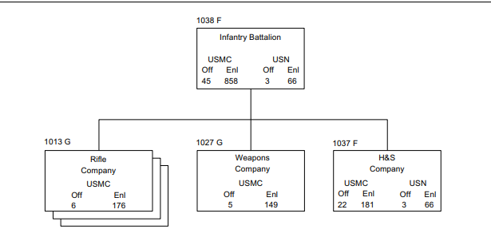
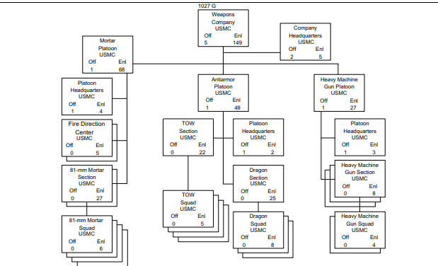
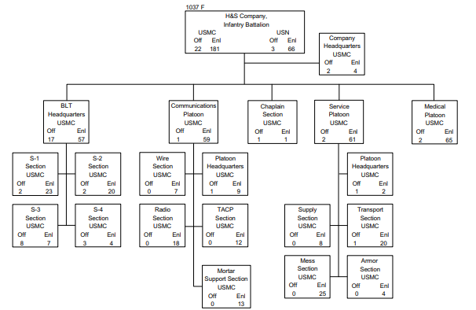

Slide 4
Innovate Manpower
Flatten the battalion
Integrate supporting shops into the companies
Merge analysts and operators
Eliminate non-combat command billets
H&S and Weapons Company Commander
Weapons Platoon Commander
Notes:
Eliminate Billets that are not there in Combat
establish long-term working relationships to develop the necessary familiarity and trust…—"actuals"—should talk directly to one another when possible, rather than through communicators or messengers.
Allow for flexibility and planning capability by adding bodies to the 3 Shop
Flatten the Command structure by adding logistics specialists to companies and bolstering the CLIC (Break down Silos)

Slide 5
Training Better
Make training the responsibility of the supporting establishment
- More repetitions
- Better training

Slide 6
Conclusions
Flatten the battalion
Maximize adaptability not efficiency
Eliminate excess command relationships that do not exist in combat
Build a dedicated training cadre for battalions

