Slide 1

exchange ideas

Slide 2
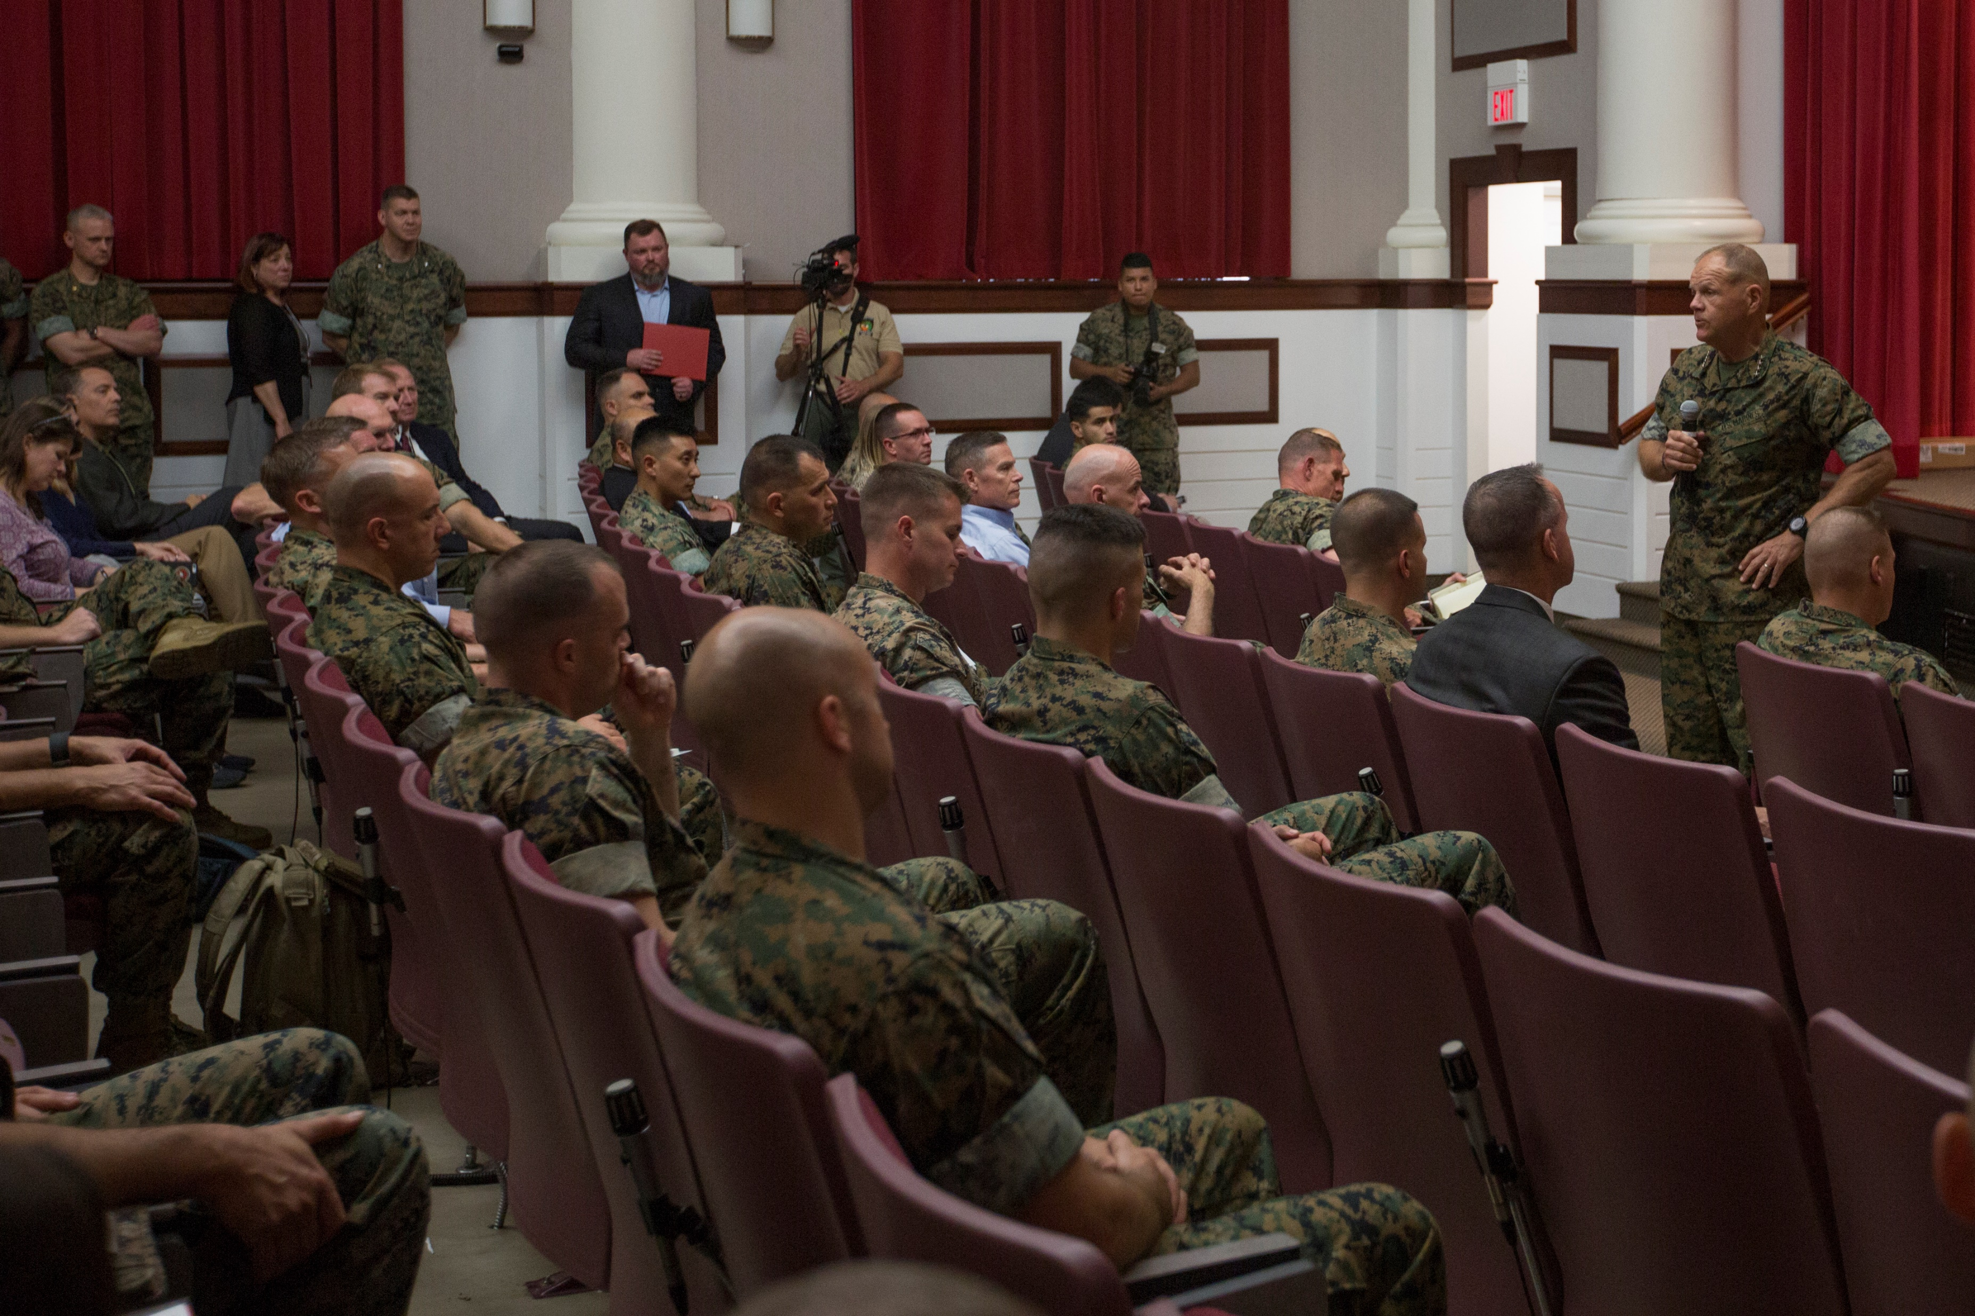
We need to
exchange ideas

Slide 3






Purpose
Capacity
Publishing Guidelines
Response Times
Levels of Discussions
CMC
Innovation
Challenge

Slide 4


Slide 5
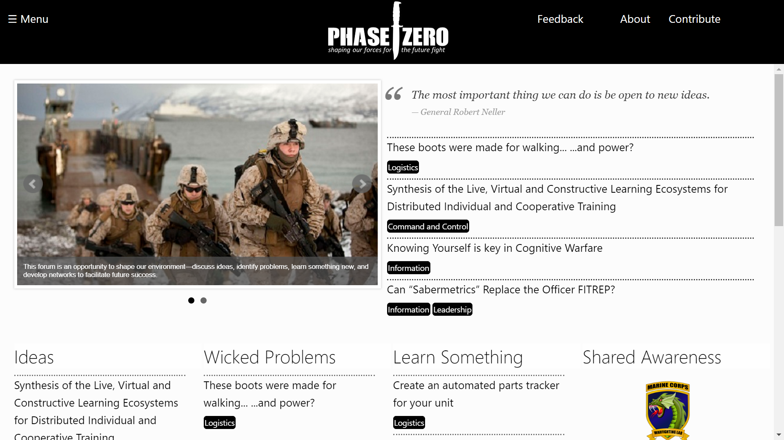
Notes:
Exchange Ideas
Solicit Solutions
Explore Resources

Slide 6
Join your fellow Marines and Sailors in shaping our Marine Corps for the future fight by contributing to the Phase Zero community.
Spread the Word
Code / Develop the Site
Serve as an editor on the board
Contribute Ideas
Submit Resources
Moderate the Community

